Slide 1
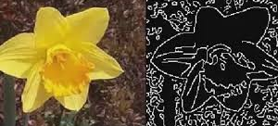
Edge detection with FPGA
Major project

Slide 2
Aim
Understanding the PYNQ design process
Rebuilding Base pipeline
Understanding and rebuild IP of CV2Pynq
Combine Base with cv2pynq IPs

Slide 3
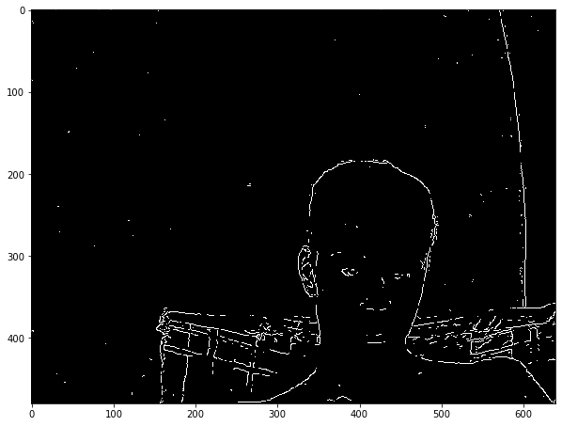
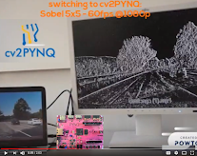
State of the art
Example code from the pynq
Cv2 pynq project

Slide 4
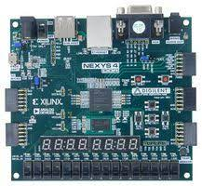
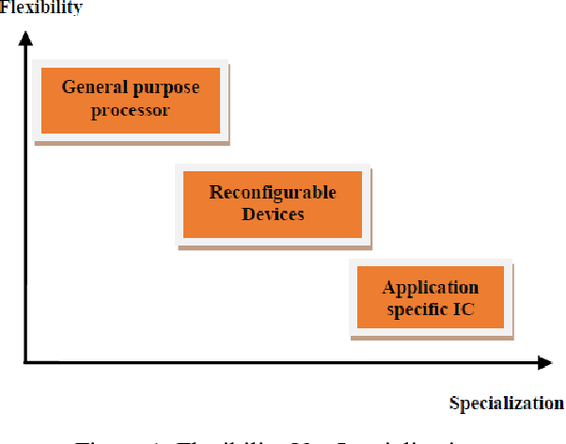
Background research
What is FPGA?
Processor vs FPGA

Slide 5
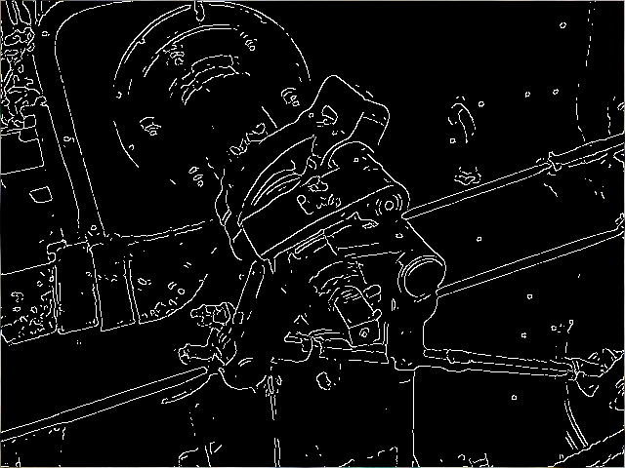
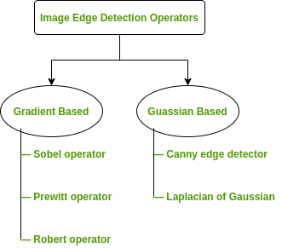
Background research
What is Edge detection
Types of edge detection

Slide 6
Project development
Testing the example of the cranny's edge detection.
Rebuilding the Vivado file of the pynq base hardware.
Building CV2pynq Ips and system
Develop and test the pipeline
Understand CV2pynq hardware

Slide 7
Innovative ideas
Built a custom overlay that was combination of Base pipeline and Cv2 library.
Runs all the examples
Enable acceleration features
Reduce load on processors for image processing and use hardware acceleration.

Slide 8
Testing and validation
RTL analysis
Frames per sounds
Runs example programs

Slide 9

Testing

Slide 10
conclusion
Improved image processing
As edge detection is used in many fields
Building IC

Slide 11
Thank you
By Shubham Haria
1st marker: zhijun yang
2nd marker: Inas El-Aroussi

